Slide 1
Predicting Movie Genre Using Different types of Neural Network
MD. Mukith Al Alim
ID: 1711376042
Sec : 02

Slide 2
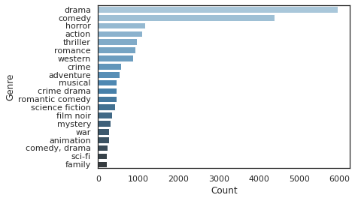
What is the Problem ?
I’ve using Wikipedia Movie Plots dataset from Kaggle.
The dataset contains descriptions of 34,886 movies from
around the world. It has 8 attributes , as: Release Year , Title,
Origin/Ethnicity, Director , Cast, Genre , Wiki Page, Plot
My task is to classify movie genre based on plot summary.
There are in total 20 types of movies. You can see that the highest number of movies are drama movie which is
near 6 thousand and then second is comedy. Here we can see that genre classes are imbalanced, so now if we build model with all the genre then our model will perform horrible.
So, we choose the top 4 genre which are drama, comedy, horror and action movies.
I apply a simple Bag-of-Words approach, a CNN-based approach, and a hybrid CNN-LSTM approach to the problem.

Slide 3
Project Methodology(Preprocessing)
Stemming
Lower case all the text
Word Tokenization (Unique tokens 93887)
Pad sequence
Final Shape of data tensor (12608, 2978)
Train test splitting 80:20.
Glove Word Embeddings layer

Slide 4
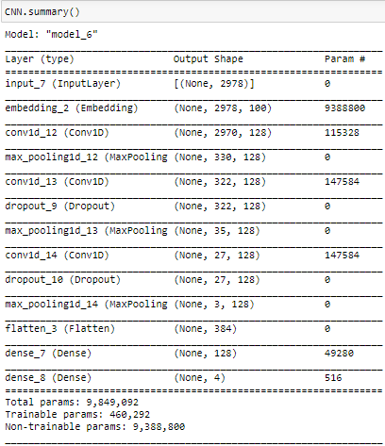
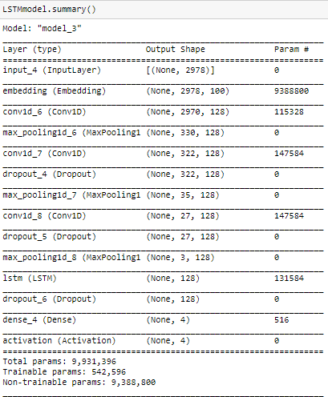
Project Methodology(Model Summaries)
CNN model with Embedding layer
LSTM model with CNN+ Embedding layers

Slide 5
Project Methodology(Parameters)
Loss Function= Categorial_Crossentropy
Optimizer= Adam
Metrics= Accuracy
Activation layer= Softmax
Epoch=10
Batch Size= 128

Slide 6
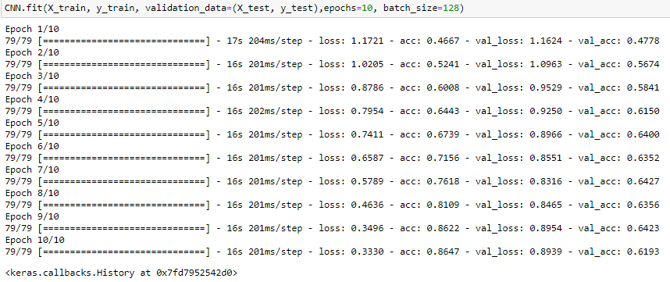
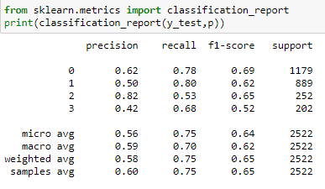
Results
CNN Model

Slide 7
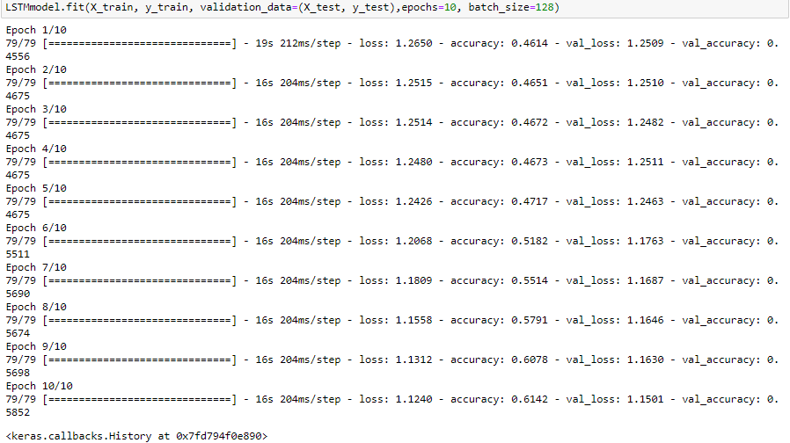
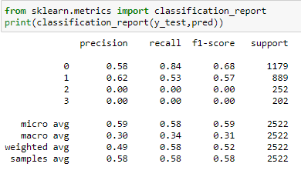
Results
LSTM Model

